Slide 1
Linux Storage and Backup Tutorials
陳秋男

Slide 2
Syllabus
Linux iSCSI target setup
Window iSCSI initiator setup
Linux iSCSI initiator setup
Linux backup tools
iSCSI Boot

Slide 3
Install Linux iSCSI Target
RHEL 6.3 x86_64
Packages:
libibverbs1-1.1.6-5.1.x86_64.rpm
librdmacm1-1.0.17-3.1.x86_64.rpm
sg3_utils-libs-1.28-5.el6.x86_64.rpm
sg3_utils-1.28-5.el6.x86_64.rpm
perl-Config-General-2.52-1.el6.noarch.rpm
scsi-target-utils-1.0.24-3.el6_4.x86_64.rpm

Slide 4
Package dependency error
# rpm -ihv scsi-target-utils-1.0.24-3.el6_4.x86_64.rpm
warning: scsi-target-utils-1.0.24-3.el6_4.x86_64.rpm: Header V4 DSA/SHA1 Signature, key ID 192a7d7d: NOKEY
error: Failed dependencies:
libibverbs.so.1()(64bit) is needed by scsi-target-utils-1.0.24-3.el6_4.x86_64
libibverbs.so.1(IBVERBS_1.0)(64bit) is needed by scsi-target-utils-1.0.24-3.el6_4.x86_64
libibverbs.so.1(IBVERBS_1.1)(64bit) is needed by scsi-target-utils-1.0.24-3.el6_4.x86_64
librdmacm.so.1()(64bit) is needed by scsi-target-utils-1.0.24-3.el6_4.x86_64
librdmacm.so.1(RDMACM_1.0)(64bit) is needed by scsi-target-utils-1.0.24-3.el6_4.x86_64
perl(Config::General) is needed by scsi-target-utils-1.0.24-3.el6_4.x86_64
sg3_utils is needed by scsi-target-utils-1.0.24-3.el6_4.x86_64
RPM install: rpm –ihv <rpm package name>

Slide 5
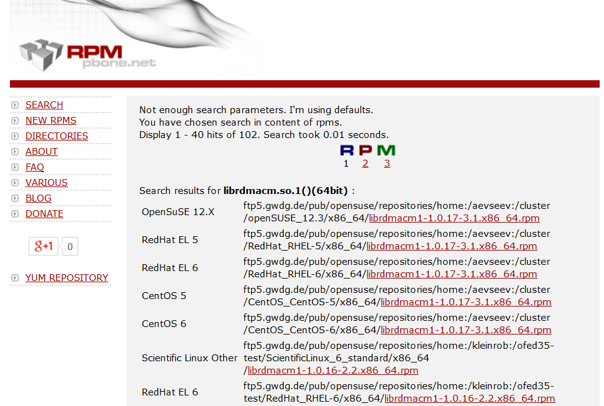
Search and download RPM packages
Download package: wget <download link>

Slide 6
Setup Linux iSCSI Target
Stop firewall (iptables)
# service iptables stop
# chkconfig --list | grep iptables
iptables 0:off 1:off 2:on 3:on 4:on 5:off 6:off
# chkconfig --level 234 iptables off
Start scsi target service
# service tgtd start

Slide 7
Setup Linux iSCSI Target, cont.
Create target device name
tgtadm --lld iscsi --mode target --op new --tid=1 --targetname iqn.2014-05.com.example:for.all
iSCSI Qualified Name (IQN)
iqn.date (yyyy-mm).domain name:naming authority
Add a logical unit (LUN)
tgtadm --lld iscsi --mode logicalunit --op new --tid 1 --lun 1 -b /dev/sdg

Slide 8
Setup Linux iSCSI Target, cont.
Allow all initiators
# tgtadm --lld iscsi --mode target --op bind --tid 1 -I ALL
IP-based restrictions
# tgtadm --lld iscsi --mode target --op unbind --tid 1 -I ALL
# tgtadm --lld iscsi --mode target --op bind --tid 1 -I 10.10.0.24
# tgtadm --lld iscsi --mode target --op bind --tid 1 -I 10.10.0.0/24

Slide 9
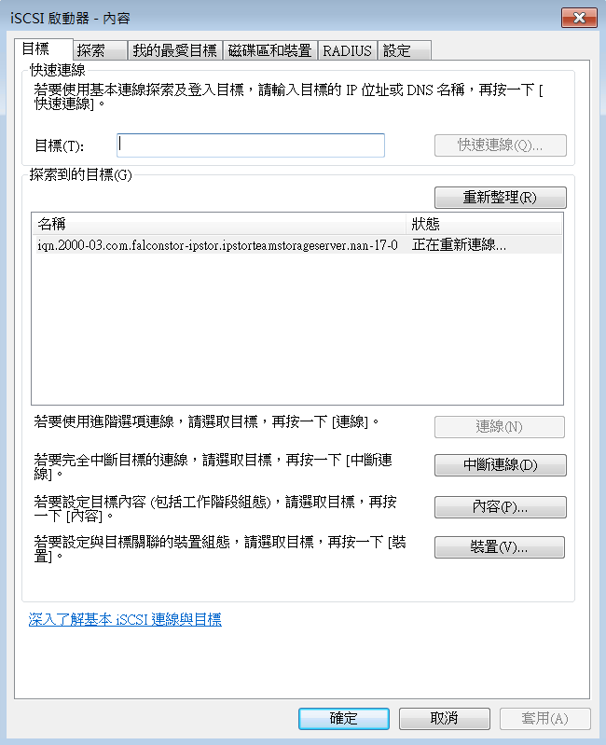
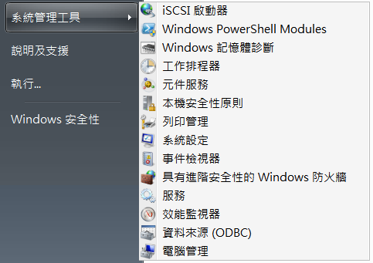
Setup iSCSI Initiator, Windows
Download: http://www.microsoft.com/en-us/download/details.aspx?id=18986

Slide 10
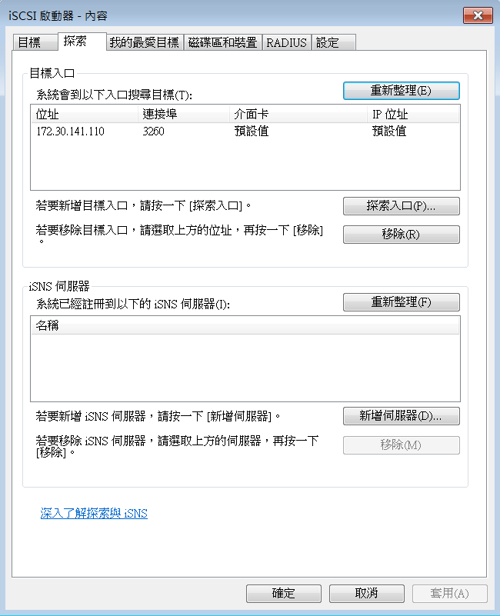
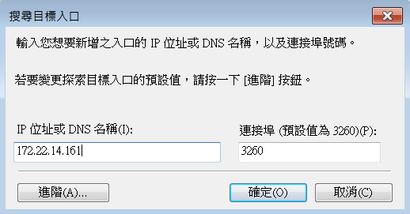
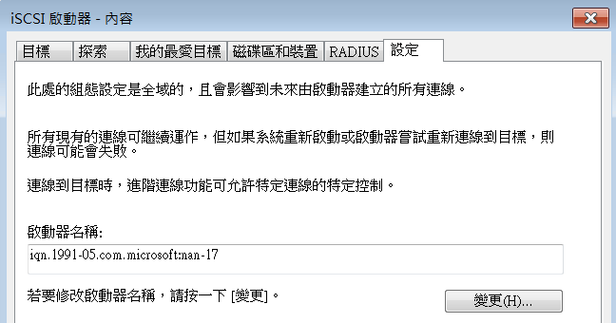
Setup iSCSI Initiator, Windows cont.

Slide 11
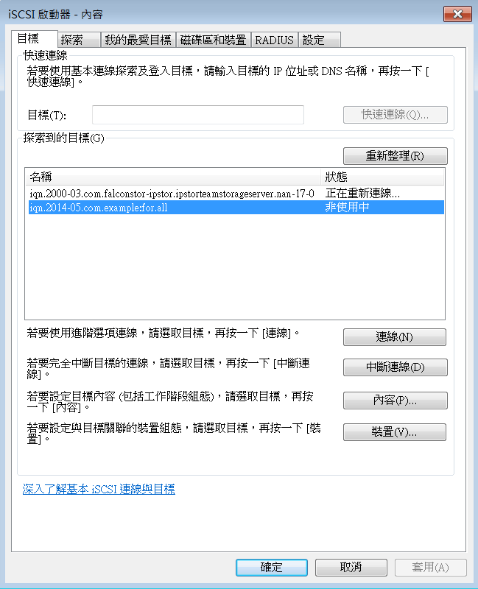
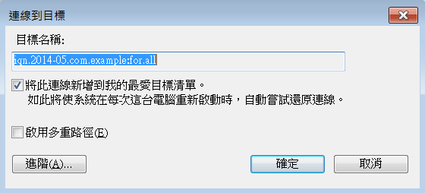
Setup iSCSI Initiator, Windows cont.

Slide 12
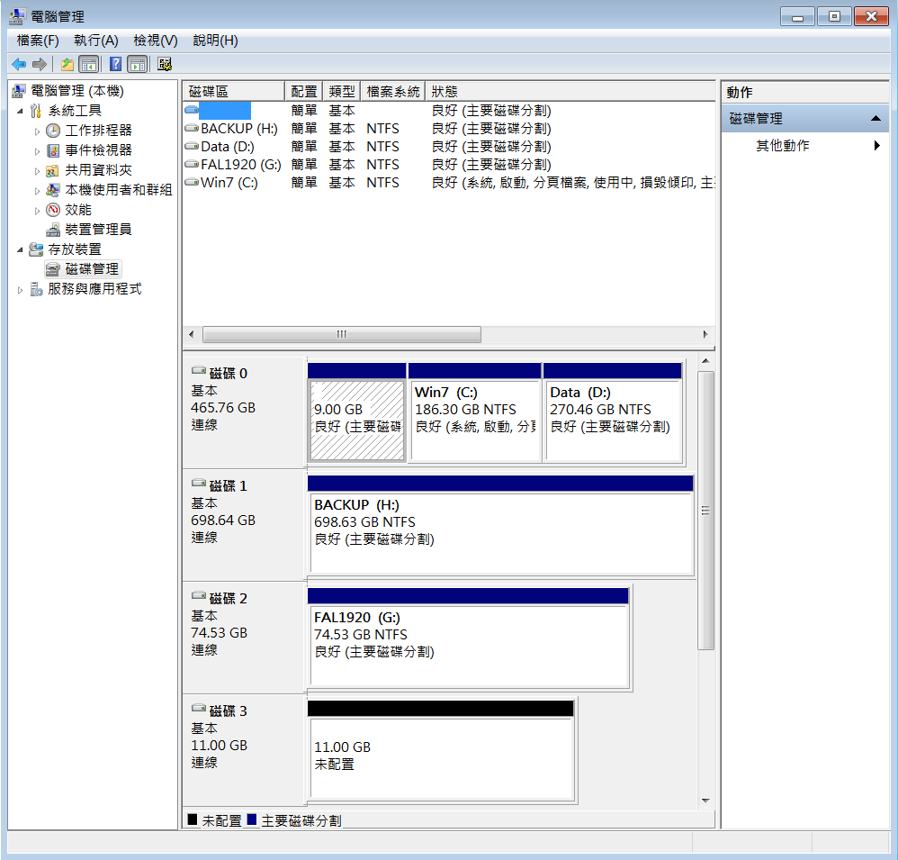
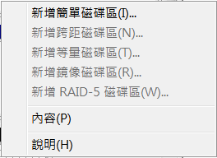
Setup iSCSI Initiator, Windows cont.

Slide 13
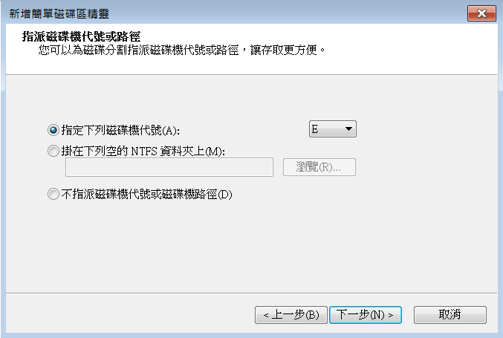
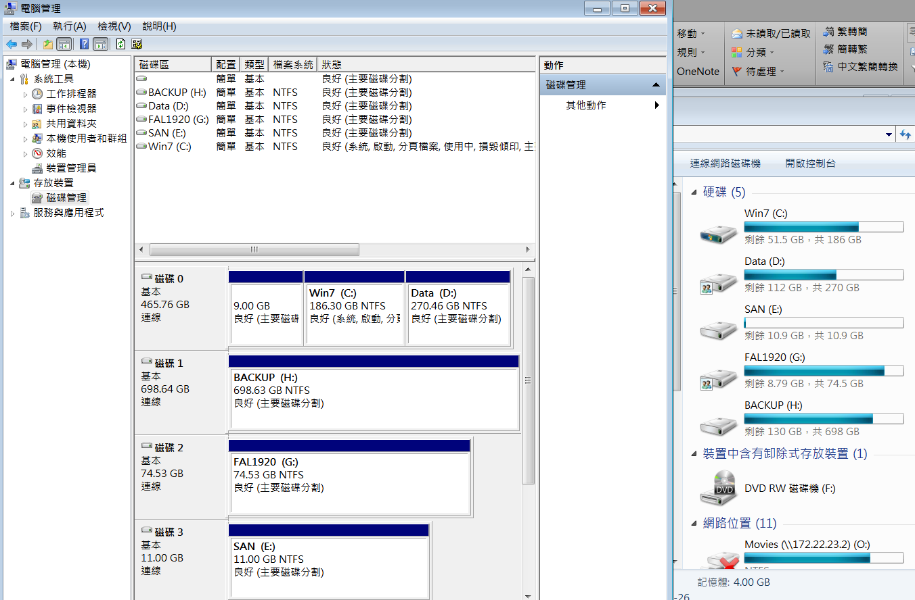
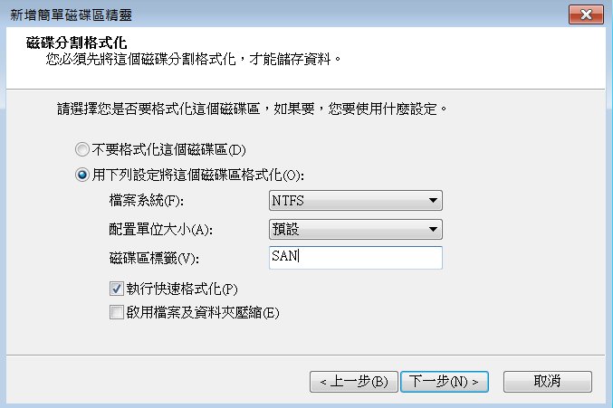
Setup iSCSI Initiator, Windows cont.

Slide 14
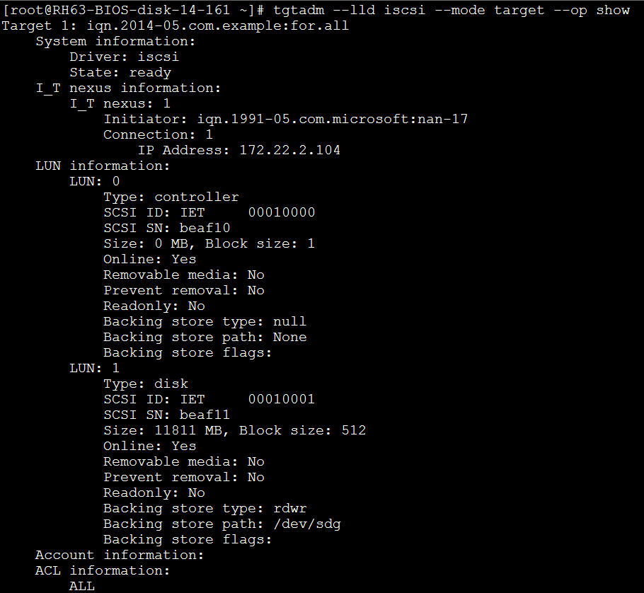
Show iSCSI Target Info, Windows
Show target status
# tgtadm --lld iscsi --mode target --op show

Slide 15
Setup iSCSI Initiator, Linux
iSCSI initiator package
iscsi-initiator-utils-6.2.0.872-41.el6.x86_64
Check iSCSI initiator service status
# service iscsid status
Check iSCSI initiator name
# cat /etc/iscsi/initiatorname.iscsi
InitiatorName=iqn.1994-05.com.redhat:266678345f80

Slide 16
Setup iSCSI Initiator, Linux cont.
Discover target
# iscsiadm -m discovery -t sendtargets -p 172.22.14.161
172.22.14.161:3260,1 iqn.2009-02.com.example:for.all
Login target
# iscsiadm -m node --targetname iqn.2009-02.com.example:for.all -p 172.22.14.161 -l
Logging in to [iface: default, target: iqn.2009-02.com.example:for.all, portal: 172.22.14.161,3260] (multiple)
Login to [iface: default, target: iqn.2009-02.com.example:for.all, portal: 172.22.14.161,3260] successful.

Slide 17
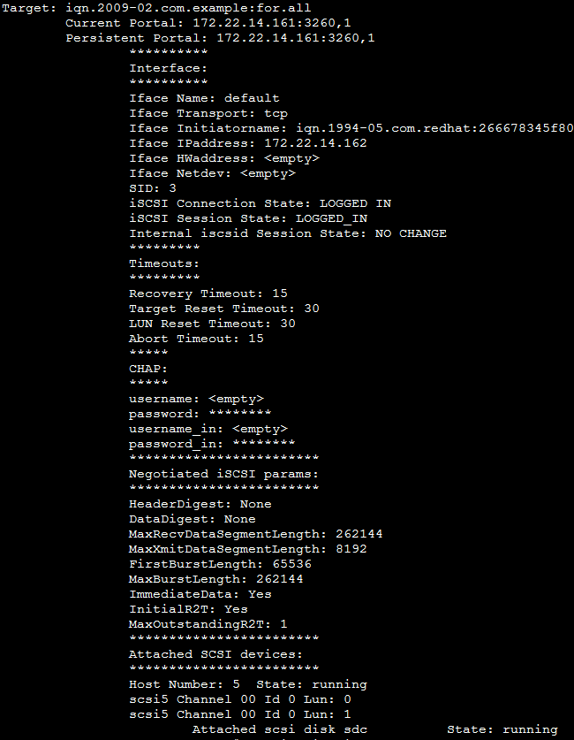
Setup iSCSI Initiator, Linux cont.
Show iSCSI status
# iscsiadm -m session --op show
tcp: [3] 172.22.14.161:3260,1 iqn.2009-02.com.example:for.all
# service iscsi status

Slide 18
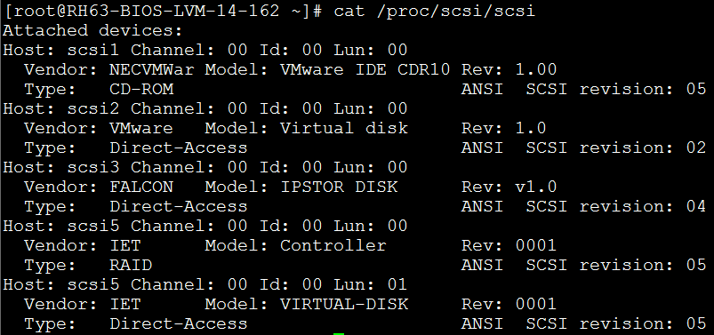
Setup iSCSI Initiator, Linux cont.
Check LUN
# cat /proc/scsi/scsi
fdisk -l
Create file-system and mount disk
# mkfs.ext3 /dev/sdc
# mount /dev/sdc /opt

Slide 19
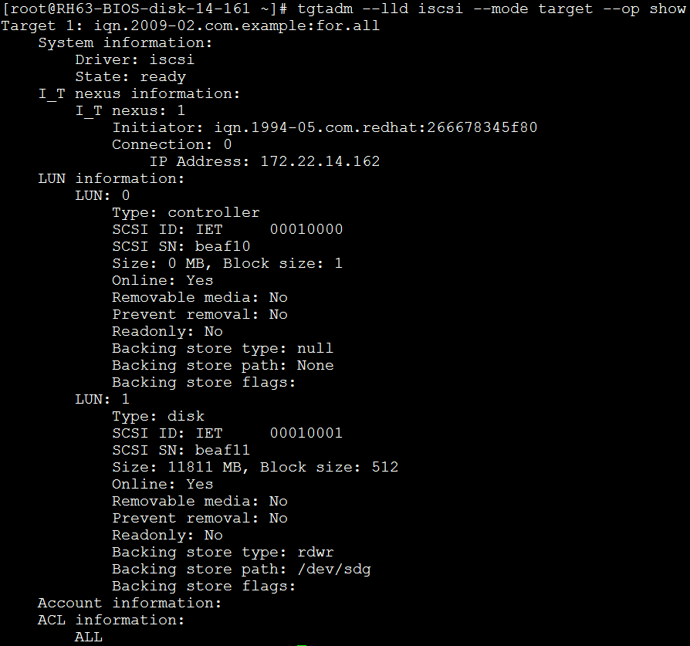
Show iSCSI Target Info, Linux
Show target status
# tgtadm --lld iscsi --mode target --op show

Slide 20
Linux File Tools – gzip, bzip, find
資料壓縮:
zip (支援將多個檔案壓縮在一起)
gzip/gunzip (.gz, .tgz)
bzip2/bunzip2 (.bz2)
尋找檔案: find
find /path –name <file-name> -print
find /path –mtime -3 (3天以內變動的檔案)
find /path –mtime +3 (3天以上變動的檔案)
find /path –mtime 3 (距今第3~4之間變動的檔案)
find /path ! –type d (找尋除了目錄以外的檔案)
查詢檔案類型: file

Slide 21
Linux Backup Tools – dd, tar
dd
dd if=/dev/sda of=/backup/root
dd if=/dev/cdrom of=cd.iso
tar
tar czvf /backup-files archive.tgz
tar xzvf archive.tgz
漸進式備份
find / -mtime -7 –print > /tmp/file-list.weekly
tar –czv –T /tmp/file-list.weekly –f weekly.tgz

Slide 22
Linux Backup Tools – cp, scp, cpio
cp
cp –R source-file dest-file
scp
ssh copy
scp –R source-file user@ip-address:/dest-file
cpio
copy any kinds of files
find /backup-files | cpio –ocv> back.cpio
cpio –idvc < back.cpio

Slide 23
Linux Backup Tool – rsync
rsync會自動比對欲複製的資料內容，而僅複製兩端有差異的檔案。
rsync –av /source-files /dest-path
在本機上的用法跟 cp用法一模一樣。
rsync –av /source-files user@dest-IP:/dest-path
自本地複製到遠端主機上，用法跟scp一樣。
rsync –av user@source-IP:/source-files /dest-path
在目的端，把遠端的資料拉過來。

Slide 24
ssh 免密碼登入 – ssh-keygen
在本地端產生自己的RSA key pair。
~]# ssh-keygen
位在 .ssh/ 下: id_rsa, id_rsa.pub
將自己的public key複製到遠端主機上。
~]# scp id_rsa.pub root@dest-IP:/root/.ssh/
登入遠端主機，並將自己的public key記錄到.ssh/authorized_keys中。
~]# cat .ssh/id_rsa.pub >> .ssh/authorized_keys

Slide 25
How iSCSI Boot Works
(PXE boot stage)
(gPXE boot stage)
(Boot from iSCSI disk stage)

Slide 26
Q&A

